Slide 1
HUMIDITY, PRECIPITATION AND CLOUDS

Slide 2
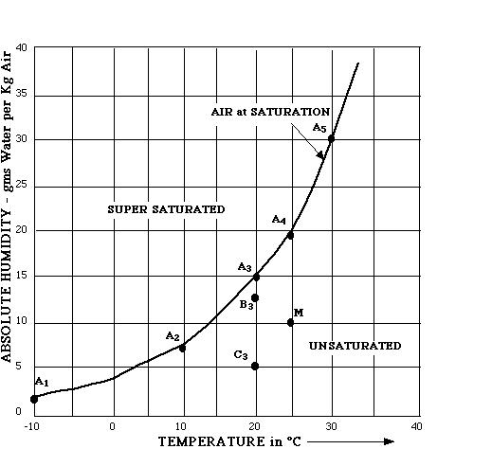
HUMIDITY, PRECIPITATION AND CLOUDS
Air is formed of 99% nitrogen and oxygen, the rest being trace gases such as argon, CO2 and water vapour.
Warmer air can hold MORE water vapour
The amount of water vapour is called humidity.
Absolute Humidity is a measure of the actual amount of water vapor (moisture) in the air, regardless of the air's temperature
Relative Humidity is a measure (in percentage) of the actual amount of water vapor in the air compared to the total amount of vapor that can exist in the air at its current temperature.
Relative Humidity= Actual water vapor x 100
Total (saturated) vapor
At same absolute humidity, which air (cold or hot air ) will have higher relative humidity?
Points A 1-5 are all at 100% relative humidity. B3 is 80%, C3 is 33%, M is 50%.
Notes:
Absolute humidity is an amount of water vapor, usually discussed per unit volume. The mass of water vapor, , per unit volume of total air and water vapor mixture, , can be expressed as follows:
Absolute humidity in air ranges from zero to roughly 30 grams per cubic meter when the air is saturated at 30 °C

Slide 3
Relationship of relative humidity, temperature and dew point
Dew point °C |  | Human perception^{[1]} | Rel. humidity at 32 °C (90 °F)
> Higher than 26 °C |  | Severely high. Even deadly for asthma related illnesses | 65% and higher
24–26 °C |  | Extremely uncomfortable | 62%
21–24 °C |  | Very humid, quite uncomfortable | 52–60%
18–21 °C |  | Somewhat uncomfortable for most people at upper edge | 44–52%
16–18 °C |  | OK for most, but all perceive the humidity at upper edge | 37–46%
13–16 °C |  | Comfortable | 38–41%
10–12 °C |  | Very comfortable | 31–37%
< 10 °C |  | A bit dry for some | 30%

Slide 4
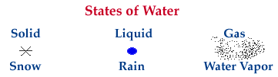
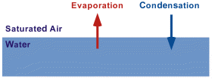
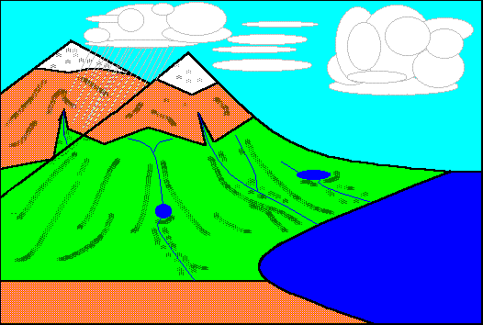
CONDENSATION
H2O can exist in solid, liquid, or gaseous states.
Change from gas to liquid is condensation.
Change from liquid to gas is evaporation.
Change to/from the solid to gas is sublimation.
Evaporation occurs where water is plentiful (over oceans, water and transpiring vegetation)
Rapid evaporation occurs over water or forests.
Condensation occurs where the relative humidity 100% (saturation) which occurs when evaporation is rapid or where the air is cooled.
When air is saturated, the rate of evaporation equals condensation
AIR COOLING occurs by:
Mixing with cooler air
Contact with cold surface
Movement (advection) over colder ground
Lifting of air up through the atmosphere
Ppt
C
E - Evaporation
T - Transpiration
C - Condensation
Ppt - Precipitation
T
Over oceans, evaporation is likely to exceed Ppt. Over land, Ppt is likely to exceed evaporation.
E

Slide 5
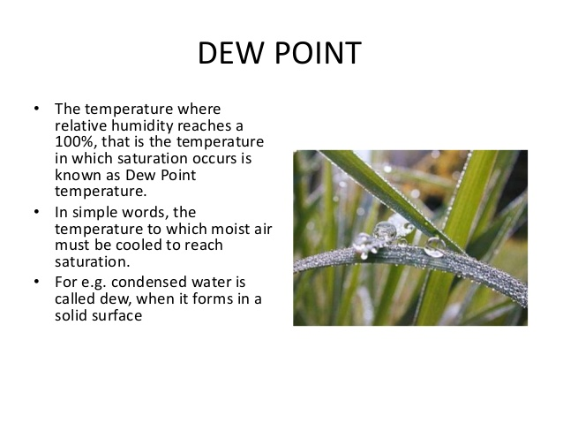

Slide 6
Gas
Condensation
Liquid
Vaporization
Sublimation
Deposition
Fusion
(melting)
Solid
Freezing

Slide 7
Gas
Liquid
Solid

Slide 8

Phase change system in context to temperature

Slide 9
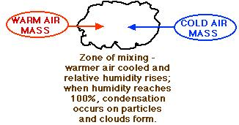
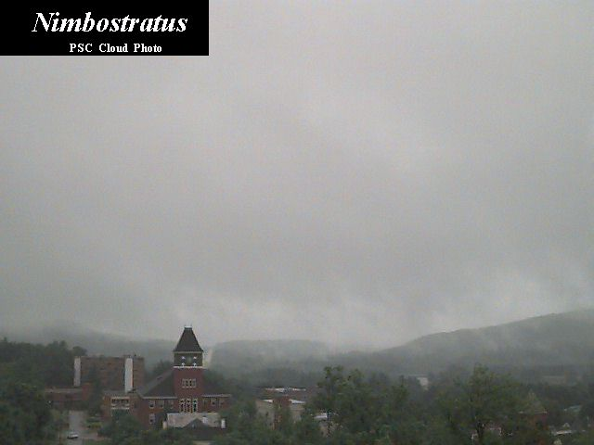
COOLING OF AIR - 1
MIXING
Condensation may occur when warmer and cooler air masses mix together at their margins
Mixing of air along a front betwen two air masses results in clouds along the front

Slide 10
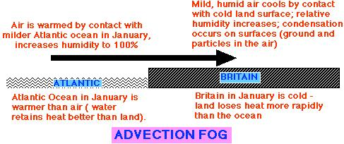

COOLING OF AIR - 2
Ground level condensation may occur due to movement of warmer air across a cooler surface (this may be land or sea). This lateral movement of air is called ADVECTION.
Here, warm air from the land is cooled when it passes over colder water (in summer, usually). Sea fogs are produced in this way, when air above warmer water moves across colder water and is cooled.

Slide 11
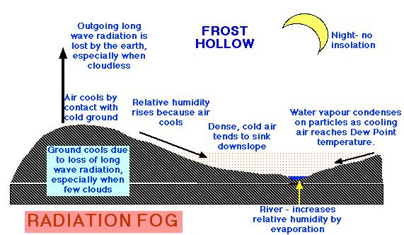
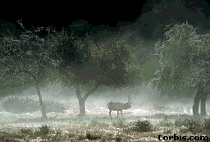

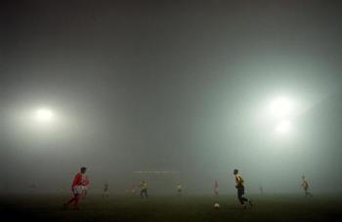
COOLING OF AIR - 3
RADIATION
Ground level condensation may also occur when stationary air is cooled by a ground surface that cools, usually overnight. Cooling is fastest when no cloud cover exists to reflect outgoing long-wave terrestrial radiation
Cold surfaces are common in mountains, where snow reflects solar radiation and remains cold, cooling air in contact with the ground.

Slide 12
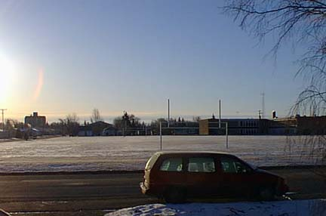


COOLING OF AIR - 2 and 3
ADVECTION
&
RADIATION
Frost forming under clear skies which aid radiation cooling of the ground
Both radiation and advection cooling result in cooling of air at ground level. If the air is cooled below its dew point temperature, condensation of the water vapour held by the air may take place on any surfaces available.
Solid ice also forms when water on the surface freezes; this is not frost, though frost may add to it.
The most available surface is the ground itself, or the vegetation. This is called dew. If dew freezes, frost is formed. If dew point temperature is below 0°C, vapour changes directly into ice, forming hoar frost.
Excessive humidity or many particles in the air cause fog, when condensation occurs on particles in the air. This is common in cities where pollution produces particles - producing smog (smoke & fog).
Frost
Dew

Slide 13
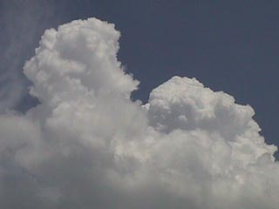
COOLING OF AIR - 4
ASCENT
When air is lifted up through the atmosphere it cools at 0.6°C per 100m
Cooling causes relative humidity to rise (cooler air can hold less water vapour).
If air cools to dew point temperature, condensation occurs on any available surfaces - at altitude, this can only be particles in the air (or aeroplanes etc)
Such particles are essential for condensation, and come from volcanic dust, sea salt from evaporated spray etc
Some, eg salt, attract water (hygroscopic nucleii) and form clouds easily.
Clouds form from such condensation. They are simply countless billions of water droplets or ice crystals too light to fall to ground. Whether ice or water depends on the altitude and temperature.
Precipitation may occur if uplift continues
UPLIFT OF AIR IS ESSENTIAL FOR CLOUD FORMATION AND RAINFALL
There are 3 mechanisms which may cause the uplift of air.

